Slide 1


Online Retail Management System
By
Batch-01

Slide 2
Batch-01
Hariharan.
S.Sharief.
Y.Niharika.
Hariram.
Harshini.
Ramya.
S.Raju.

Slide 3
Agenda
Build the project according to the needs and requirements
Use agile methods for development
Follow software engineering guidelines
Learn and use tools such as C#, Asp.Net MVC 5, JavaScript and Bootstrap.

Slide 4
Disclaimer
This HappyRetail website is made by Batch-01 for educational purpose under the guidance of Manipal edu. during short term training period for Cognizant Inhouse Trainees. This website should not be used for competent legal use. The developed website is with the inexperience of group member with the scope of re-engineering in future.

Slide 5
Introduction
The Happy Retail online Shopping cart is a web application for Online Shopping.
A Users can view the details of all the Products , but for Purchasing products registration is required.
The Admin can Add products ,category and can able to edit and delete the products and categories.

Slide 6
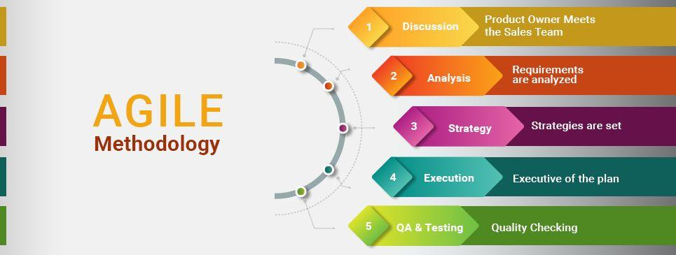
agile

Slide 7
Agile Methodology
The entire project will follow the Agile methodology, SCRUM to be precise.
Product Backlog
Structured Sprints with Timelines
Sprint Initiation and Planning
Sprint Daily Meeting
Sprint Review Meeting

Slide 8
Asp. Net Mvc
The ASP .NET MVC is an open source web application framework that implements the model-view-controller (MVC) pattern.
MVC allowes software developers to build a web application as a composition of three roles: Model, View and Controller.
The MVC model defines web applications with 3 logic layers:
Model(business Layer)
View (display layer)
Controller (Input Control)

Slide 9
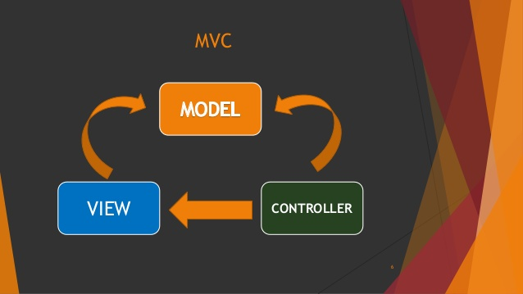
MVc

Slide 10
Mvc flow
Incoming request directed to controller.
Controller processes request and forms a data Model
Model is passed to View
View transforms Model into appropriate output format
Response is rendered

Slide 11
Tasks and Work flow of project
Captured requirements with the help of user stories.
Planned sprints and conducted daily scrums.
Designed the database schema based on phases.
Designed the front end and UI for various roles and functionalities.
Implemented the functionalities using Asp.Net MVC.
Integrated various modules to build a functional HappyRetail Online Shopping cart.

Slide 12
Functional requirements
User Friendly Web based GUI
User registration and login screen
Search bar to search the product
Product Details display screen
Cart screen
Shipping screen
Admin screen with adding products , categories , and viewing order details.

Slide 13
Project team
Project Stake-Holders
Project Title | Online Retail Management System
Name of Client | HappyRetail
Scrum Master | Hariharan
Developers | Sharief, Y.Niharika, Harshini, Ramya, HariRam, Raju.

Slide 14
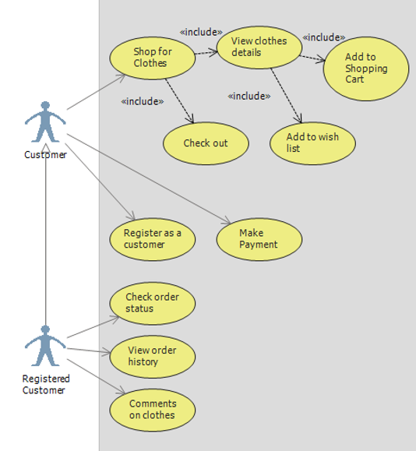
Use case diagram

Slide 15
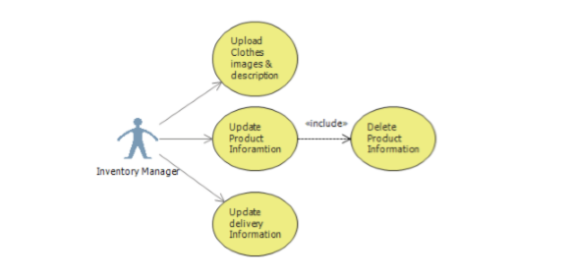
Use case diagram

Slide 16
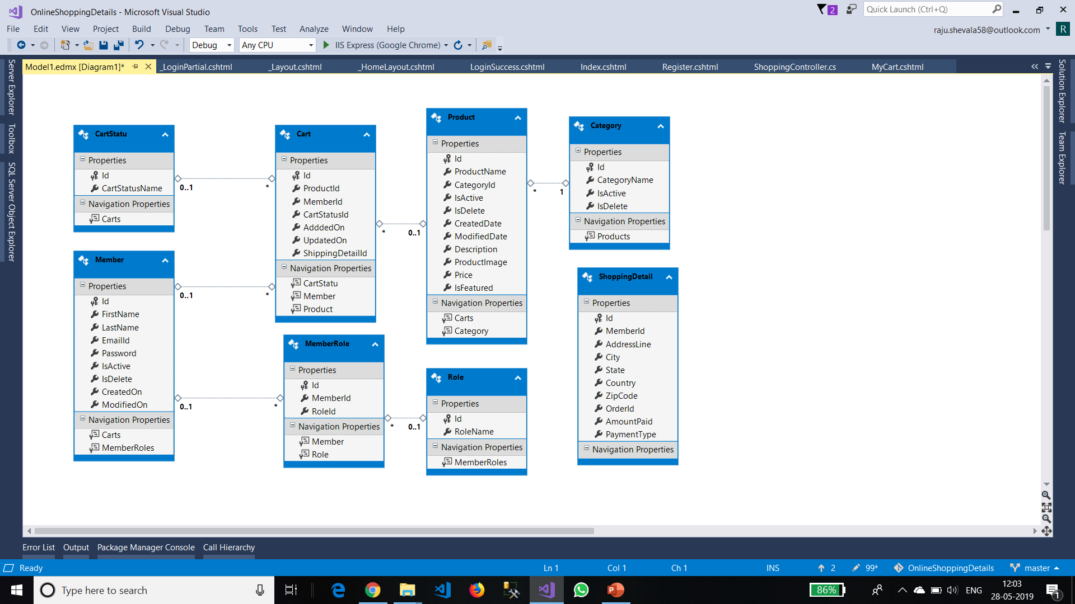
Class diagram

Slide 17
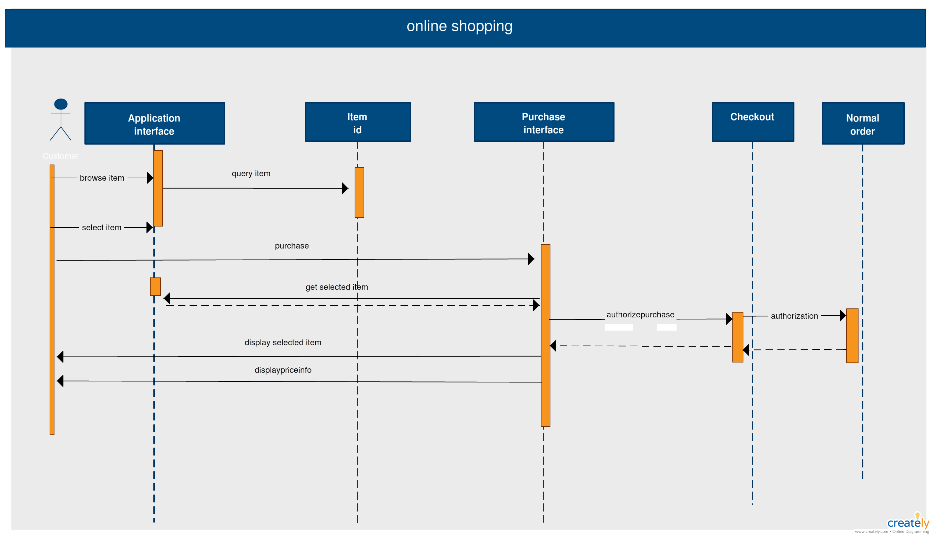
Sequence diagram

Slide 18
The tech stack
SERVER SIDE | CLIENT SIDE
ASP .Net MVC MS Sql Server | HTML5,CSS,Bootstrap. JavaScript.

Slide 19
Ide and other tools
Tools | Software
C# and ASP .NET MVC IDE | Visual Studio 2017
Web Server | IIS 7
Database | MS SQL 2014

Slide 20
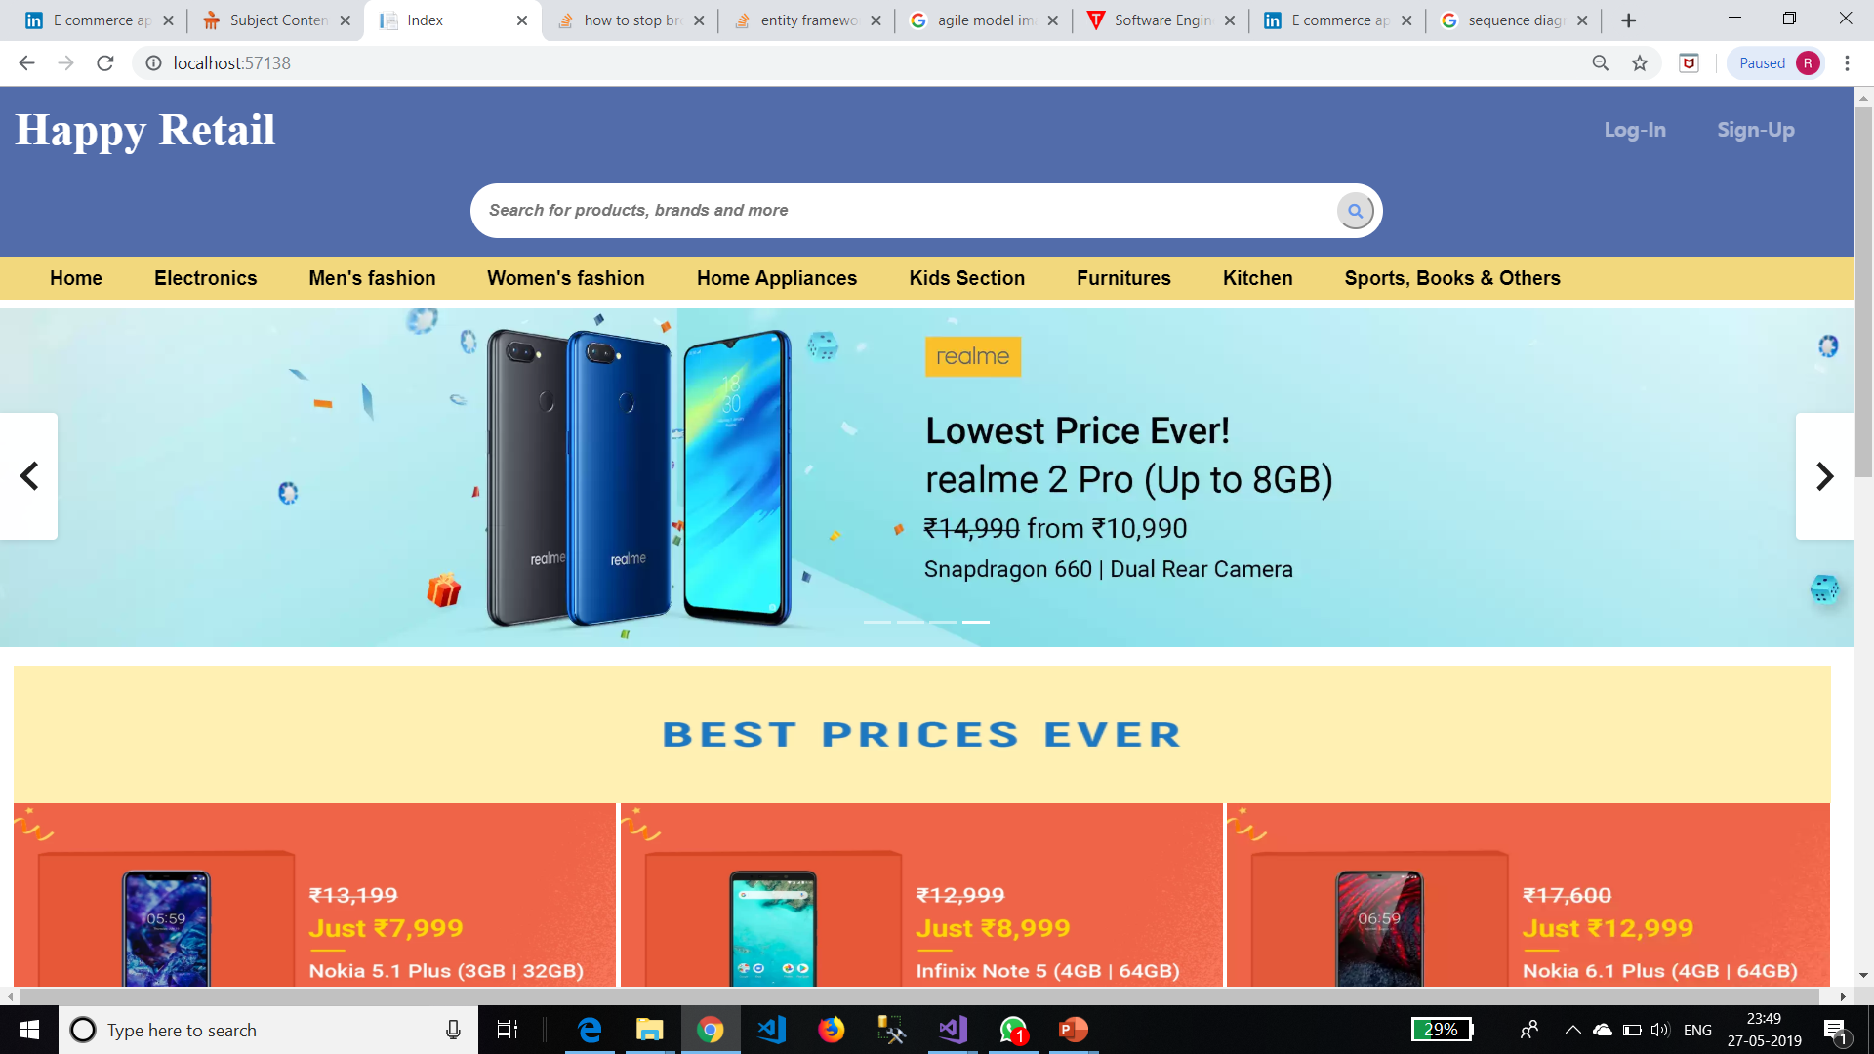
HAPPY RETAIL

Slide 21
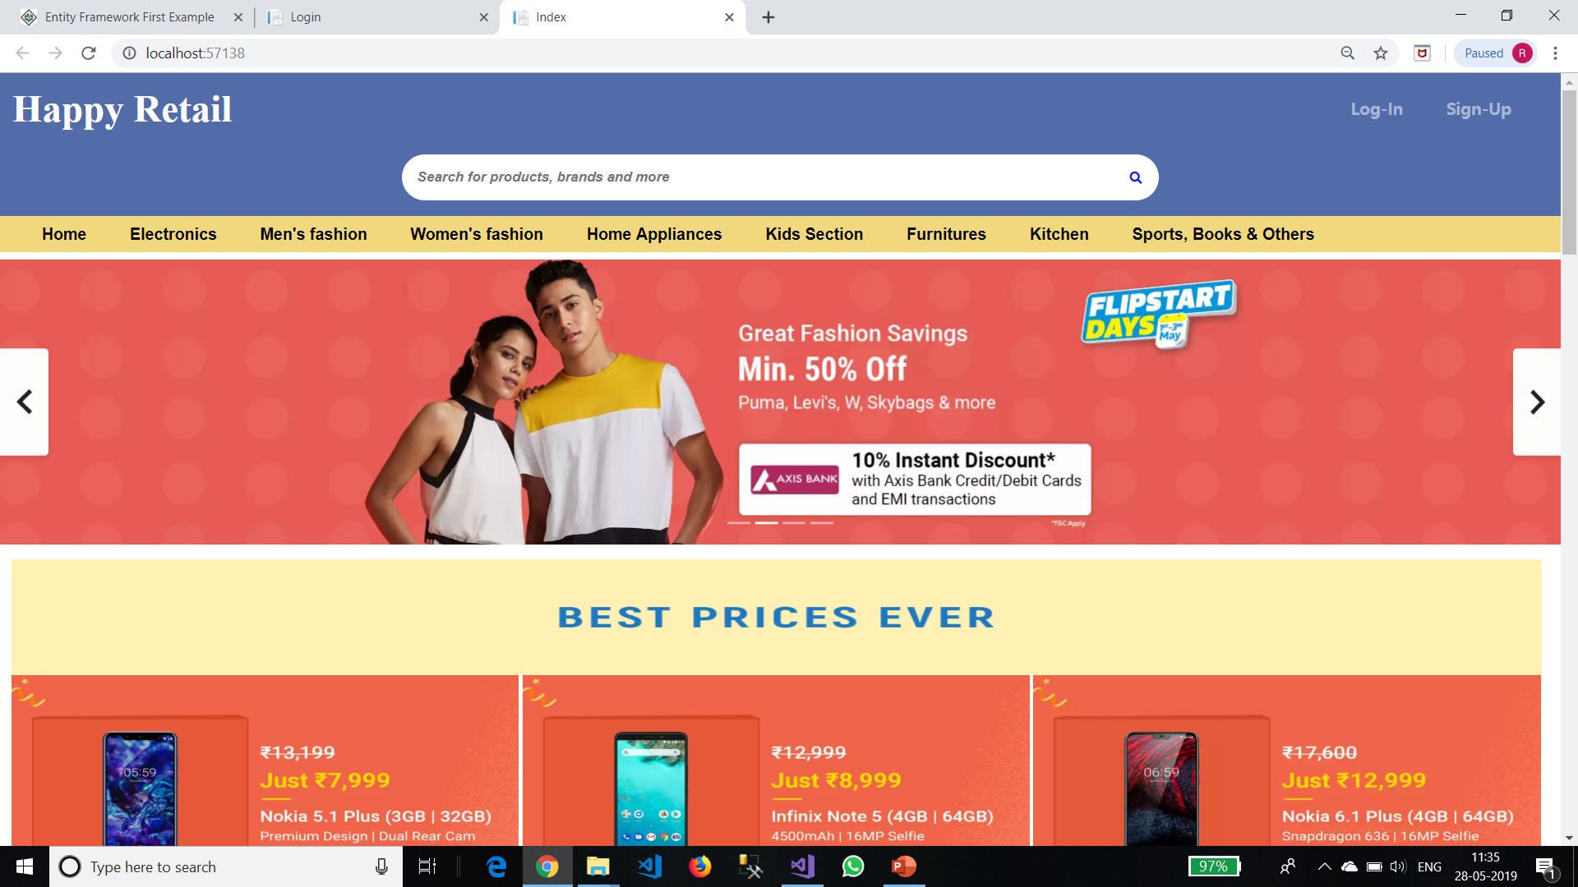

Slide 22
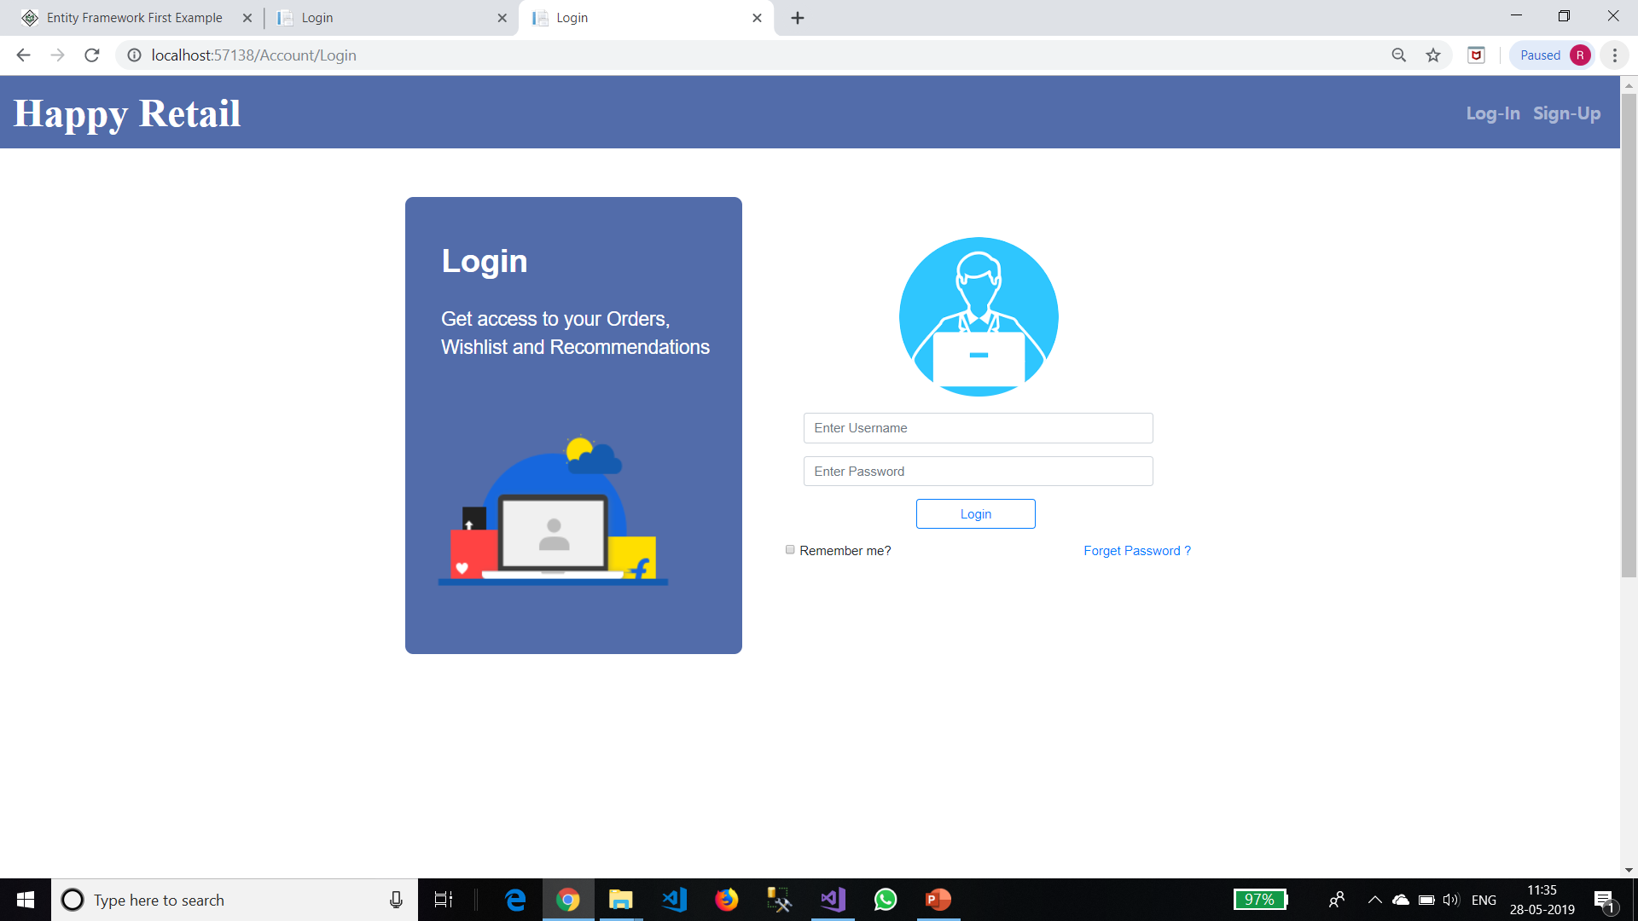

Slide 23
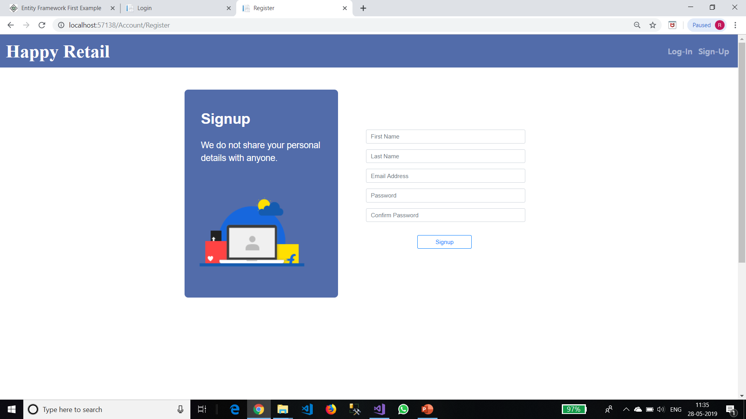

Slide 24
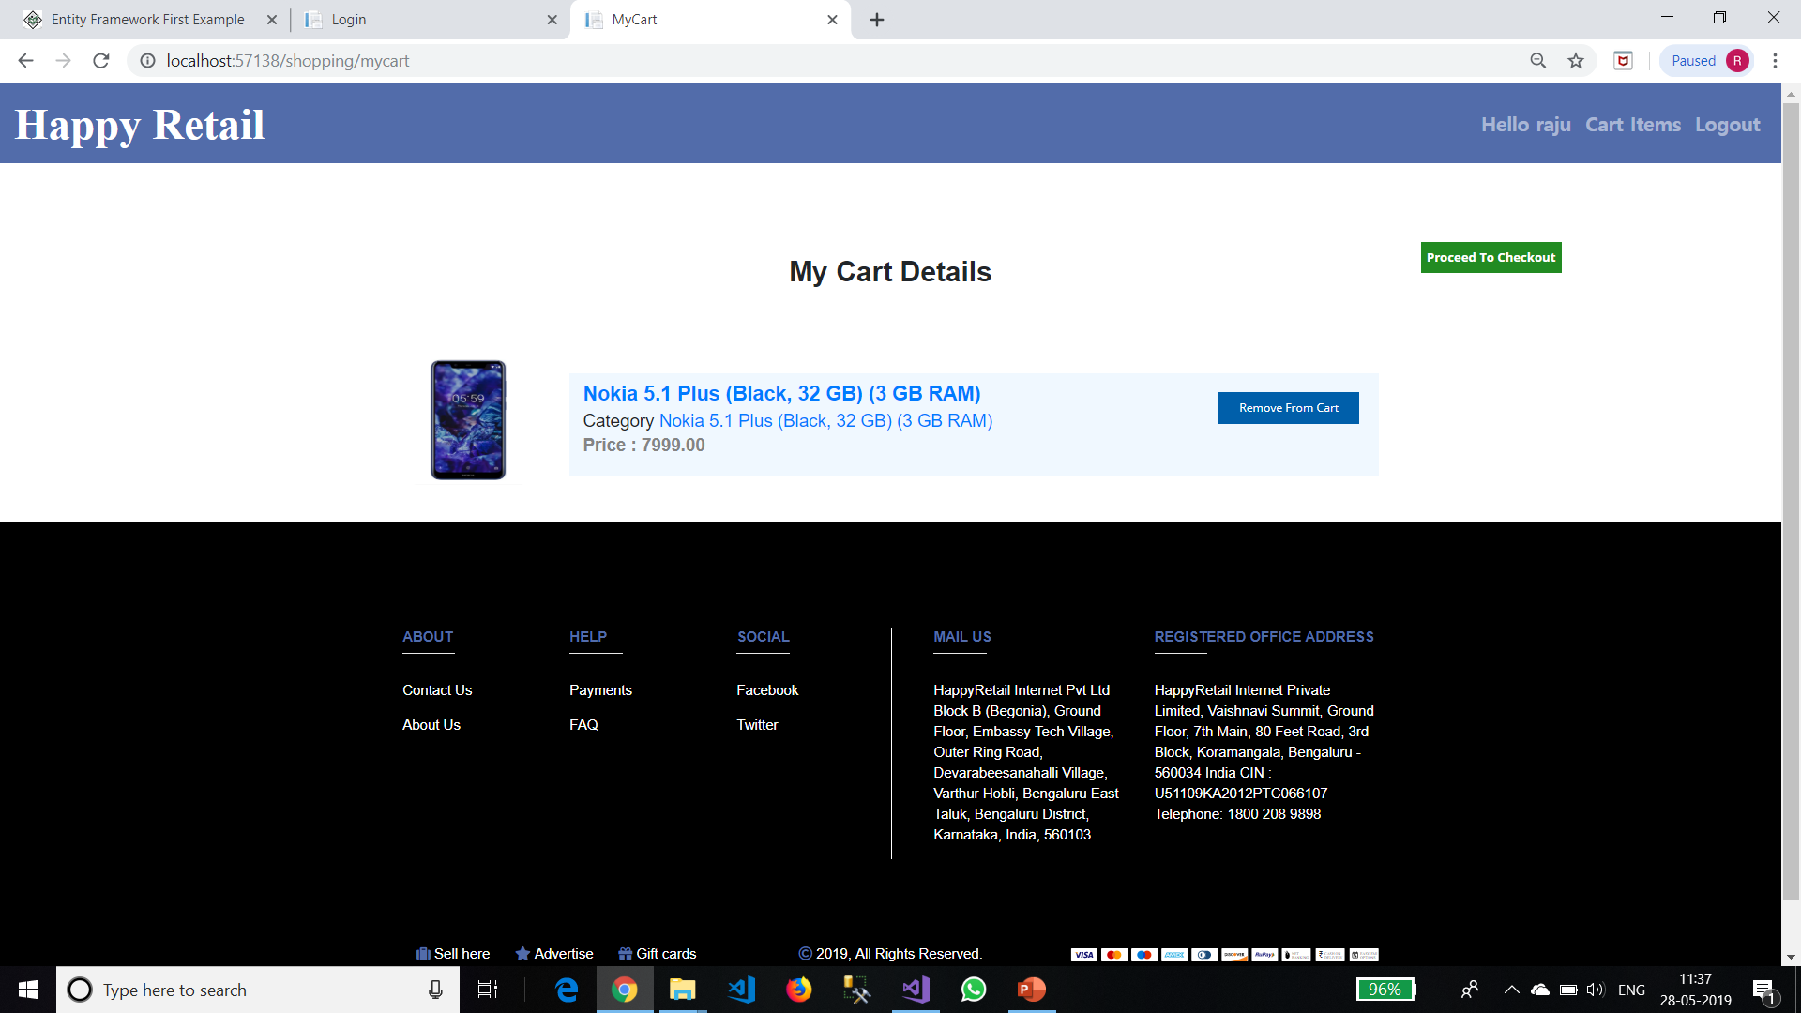

Slide 25
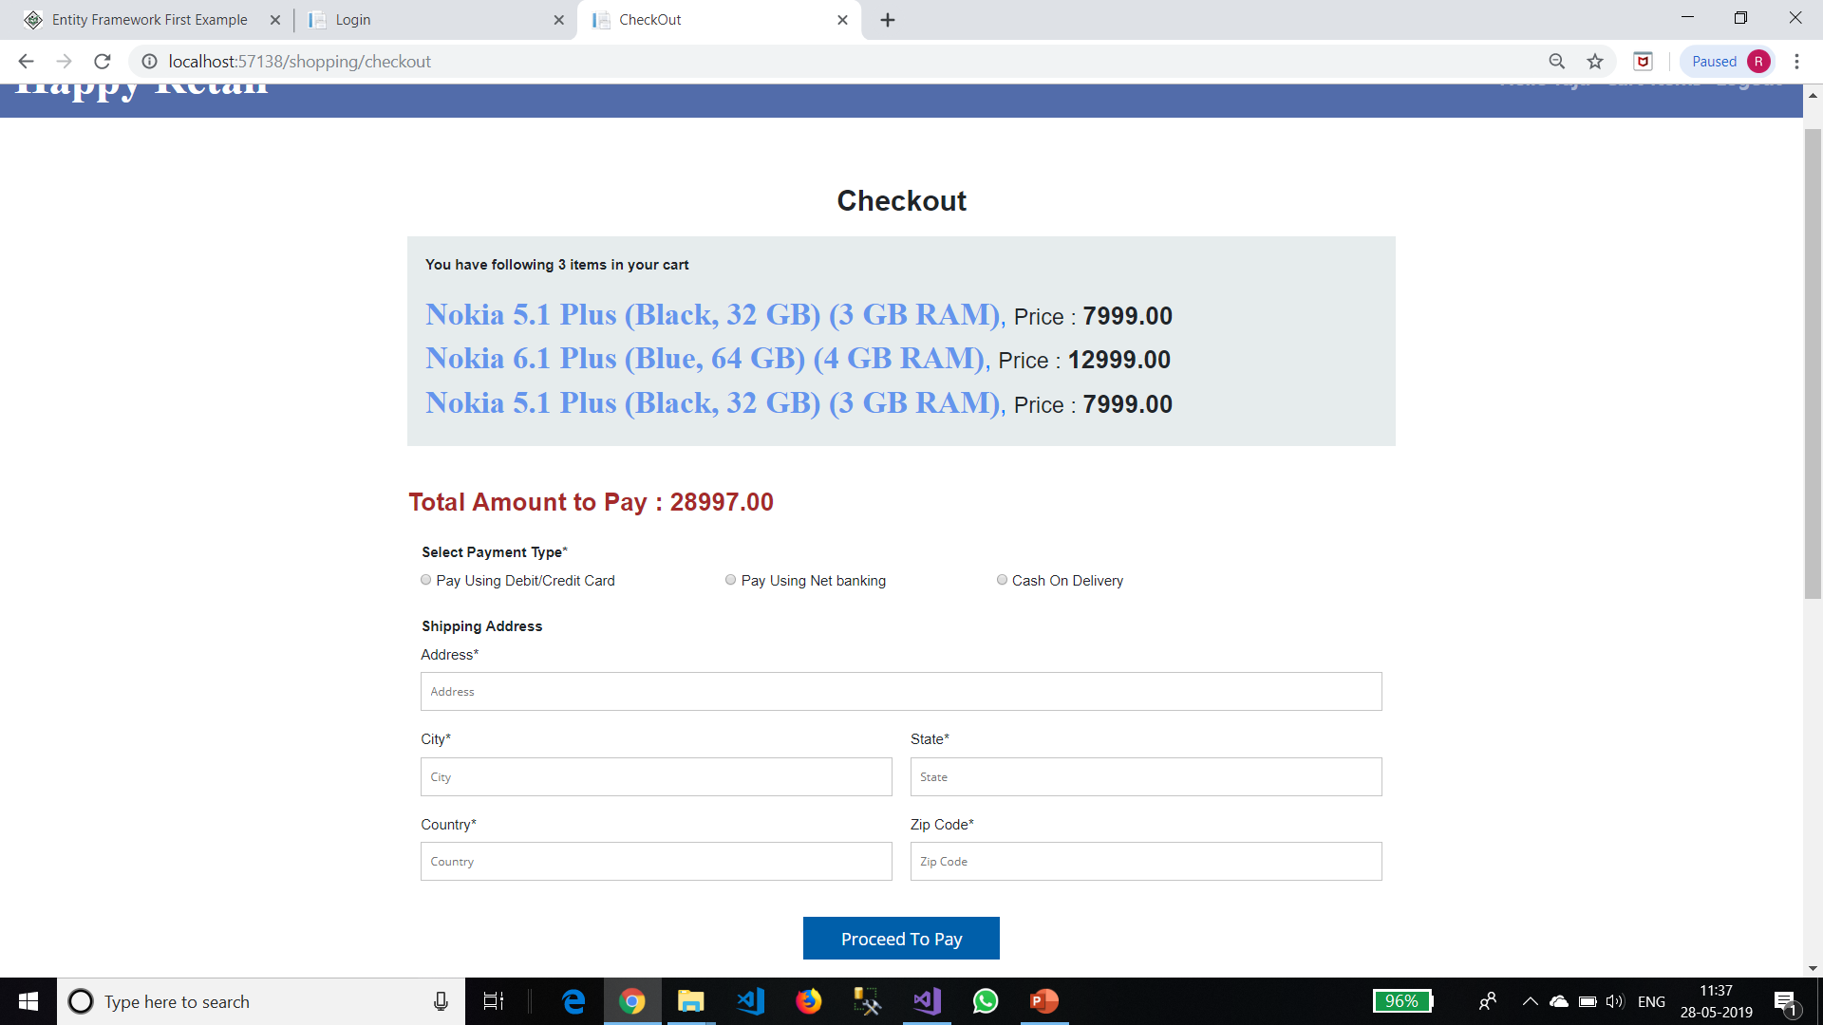

Slide 26
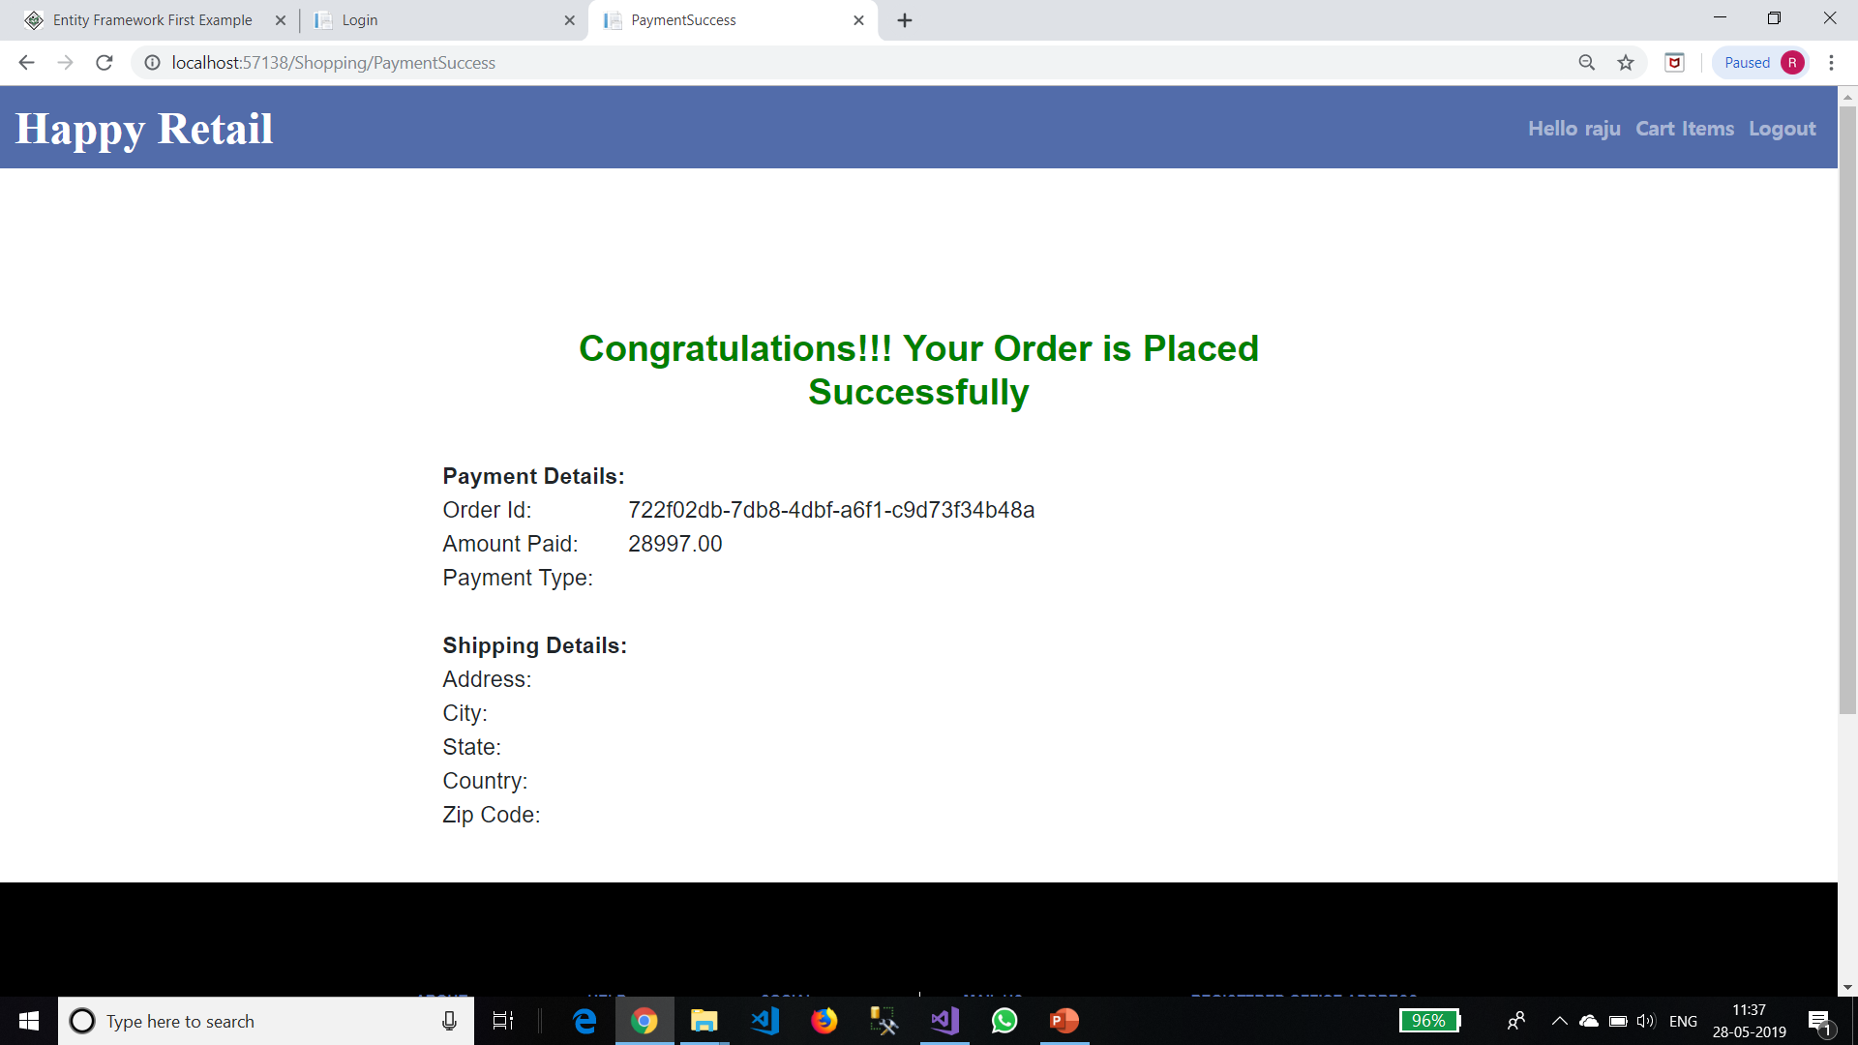

Slide 27
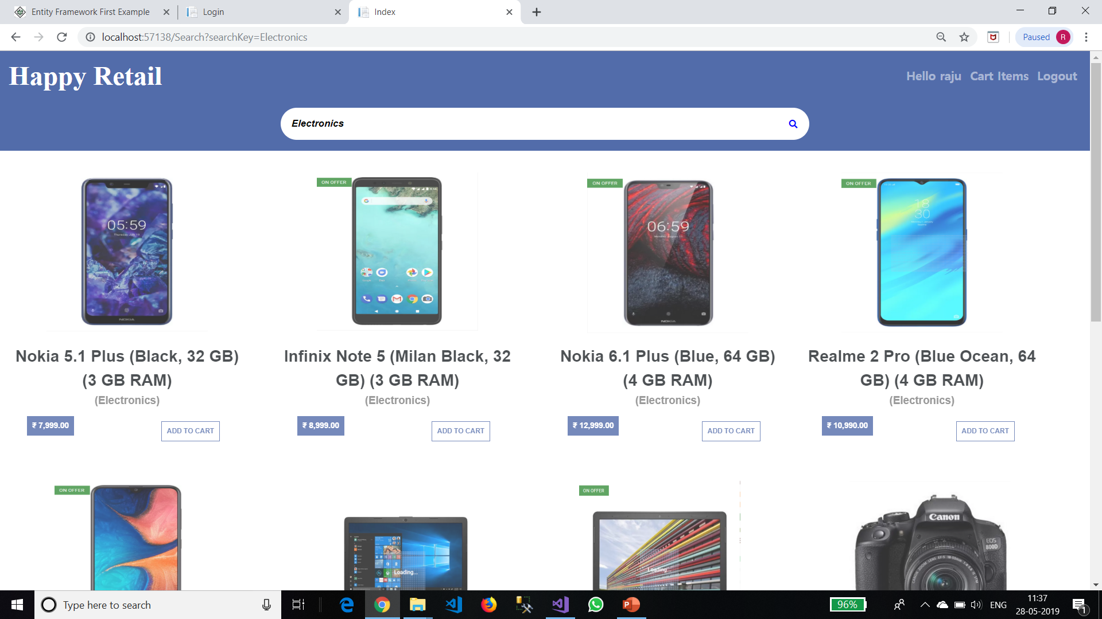

Slide 28
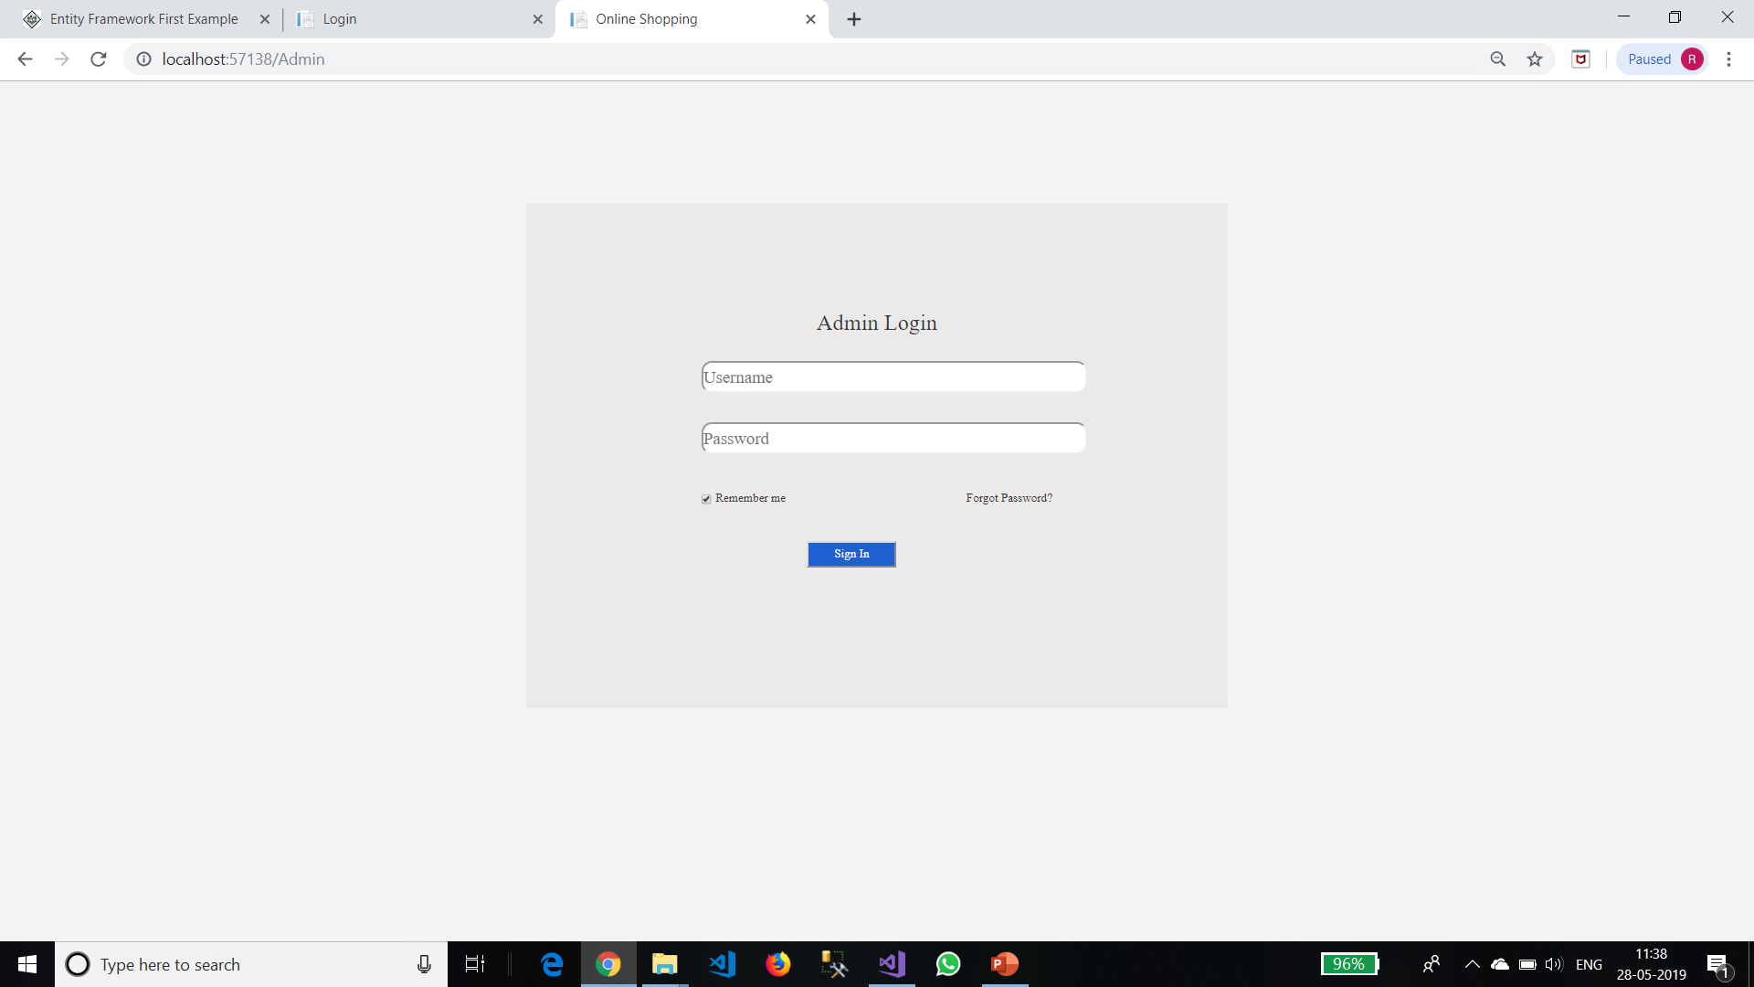

Slide 29
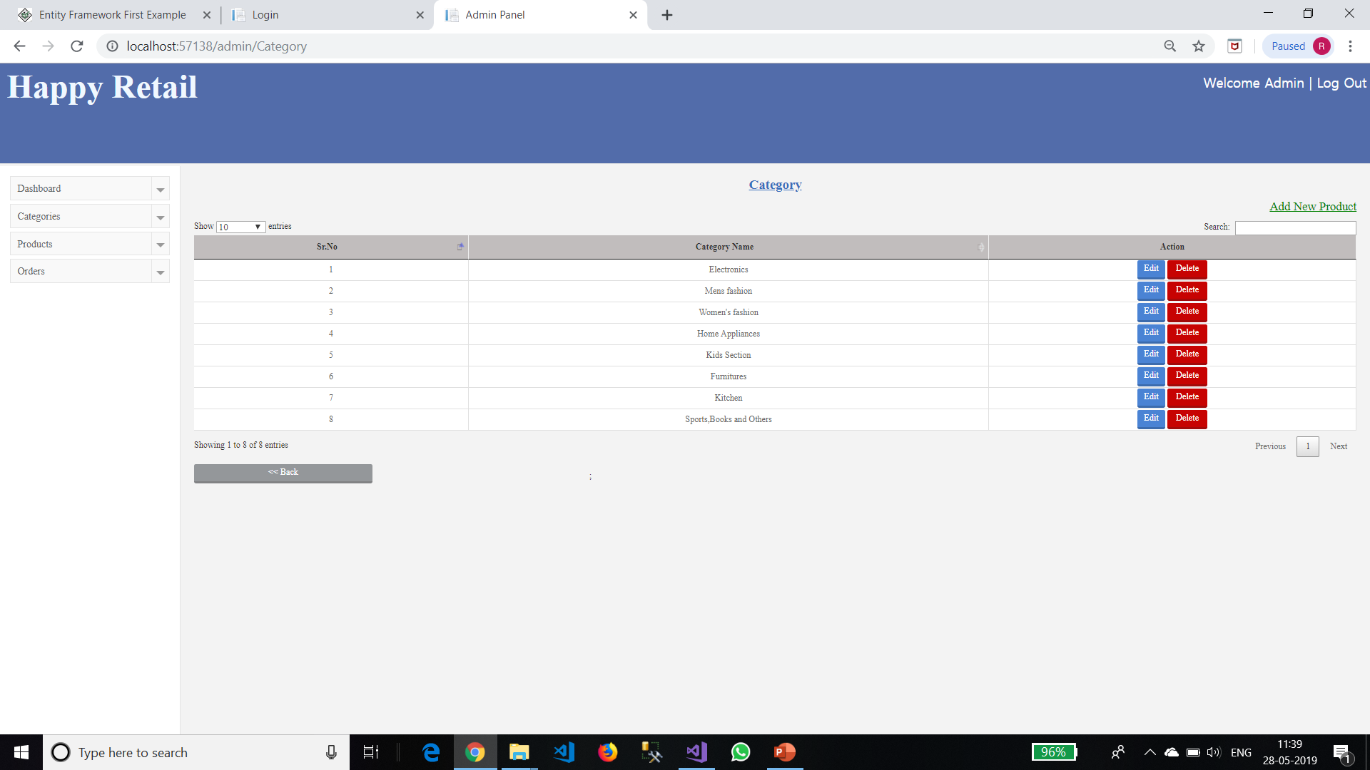

Slide 30
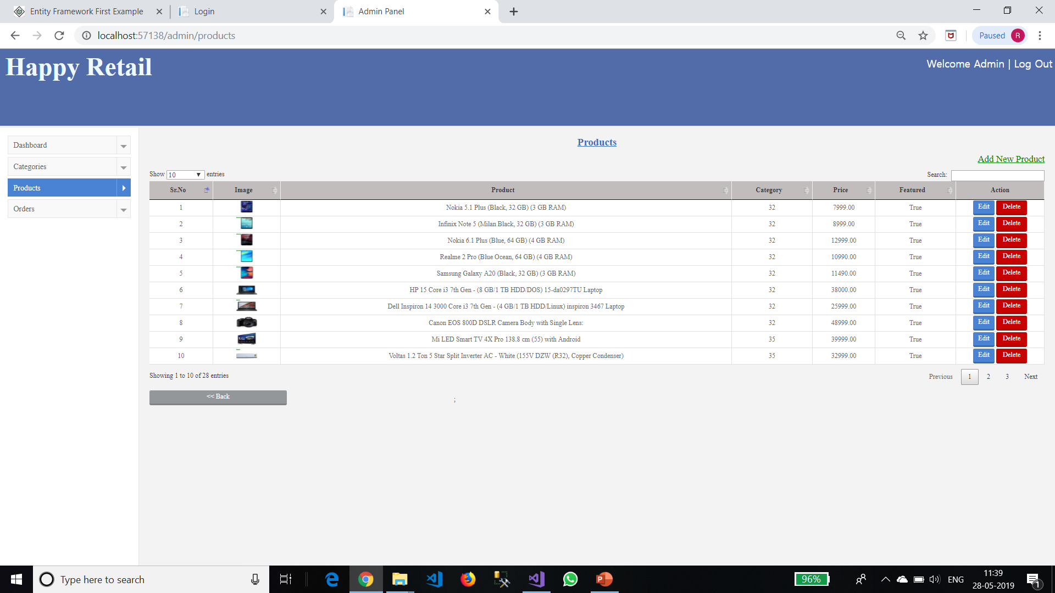

Slide 31
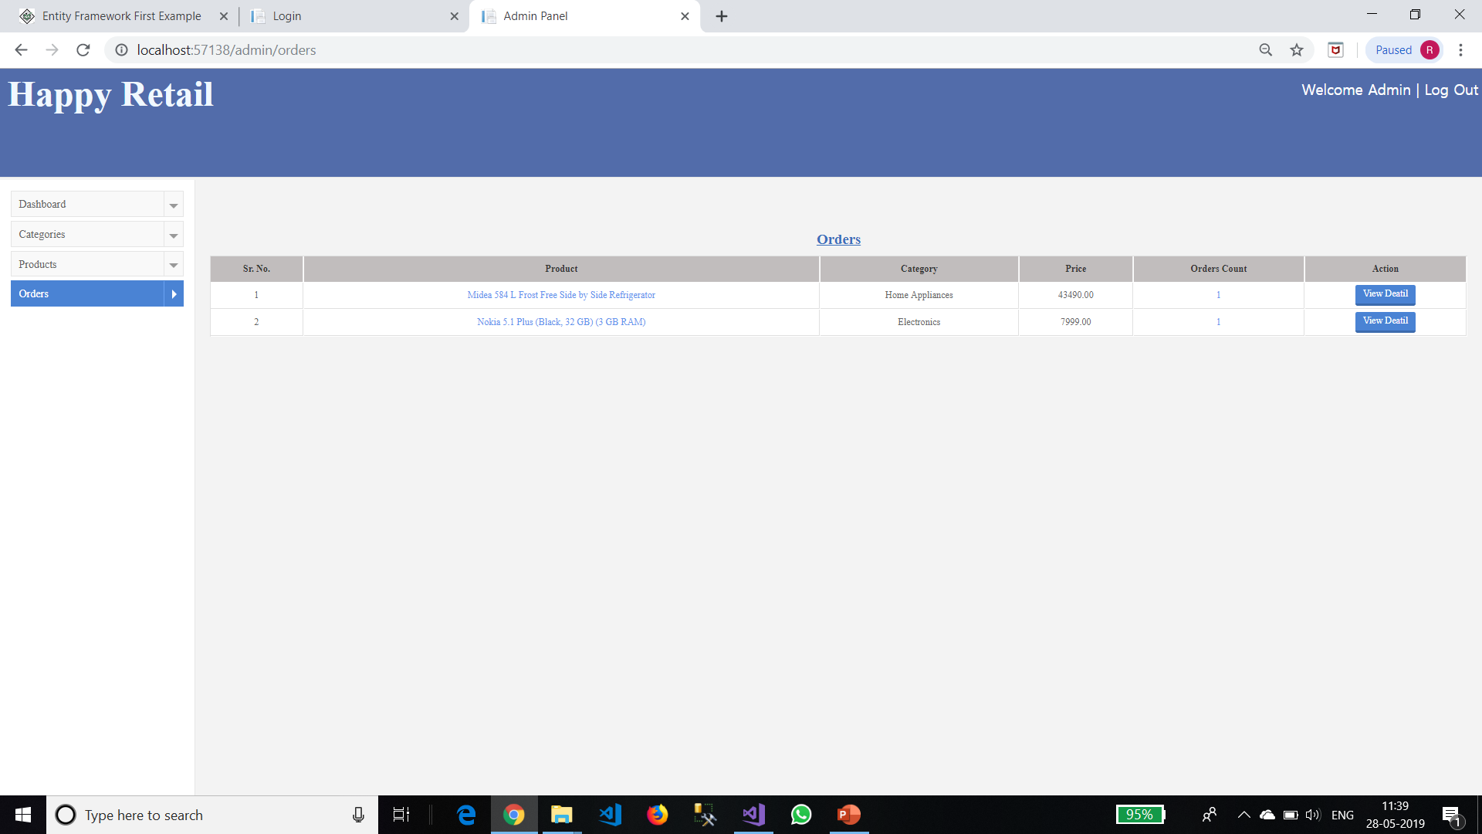

Slide 32
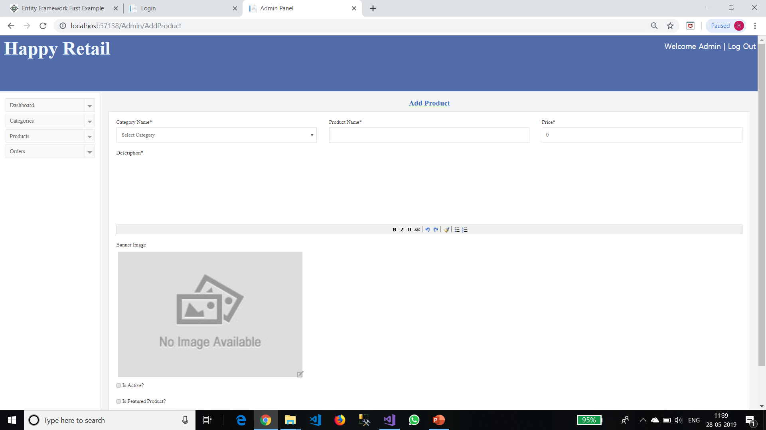

Slide 33
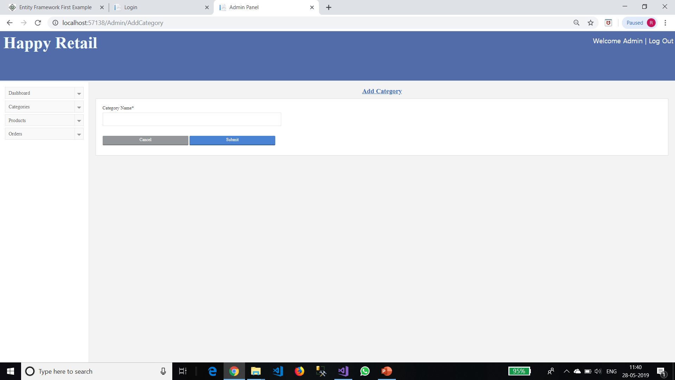

Slide 34
Thank You..!!!!

